Slide 1
Question 1: How does the number of inspections change over time (use month as the level of temporal granularity)? Does the number of inspections increase or decrease over time? Are there any peak times? Is there any seasonal effect (like inspections being more common during certain seasons or months)?

Slide 2
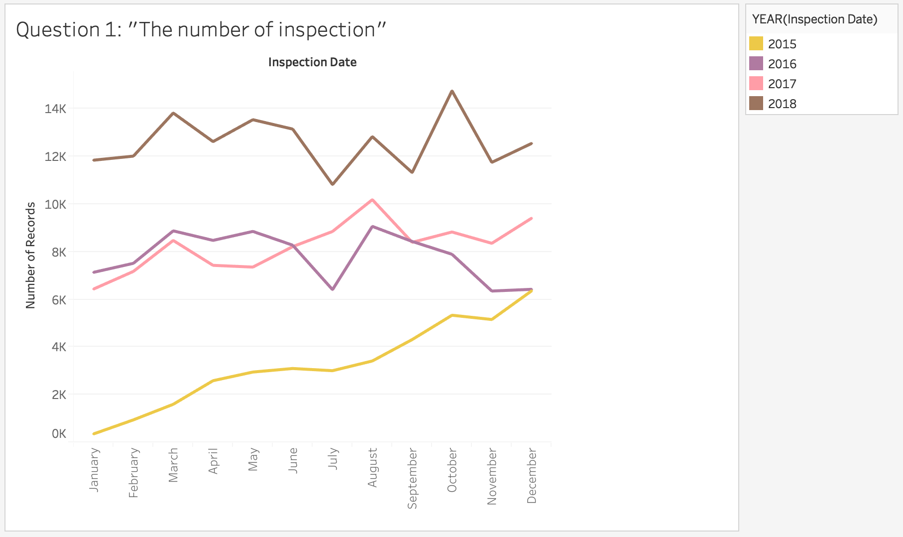

Slide 3
Answer to question 1:
The illustrated graph provides information about how the overall number of inspections changes over time (month used as level of granularity), and only the last few years used to show pattern. Overall, the number of inspections shows generally upward trends despite of fluctuations except in 2016. According to the diagram, we can explore that in each year the starting point of number inspections increases dramatically. For instance, in January 2015 the number of records was less than 1k, however, in the next following years the number of years accounted for more than 6k. Another significant feature is that from January to March and July to August, there was a significant rise in each year that confirms to be certain seasonal period where the number of inspections goes up. Additionally, the most greatest number of inspections the last four years was in October, 2018, where the number of reaches a peak that exceeds 14k records

Slide 4
Question 2: Is there any difference in how the number of inspections changes over time in the 5 different boroughs of New York City?

Slide 5
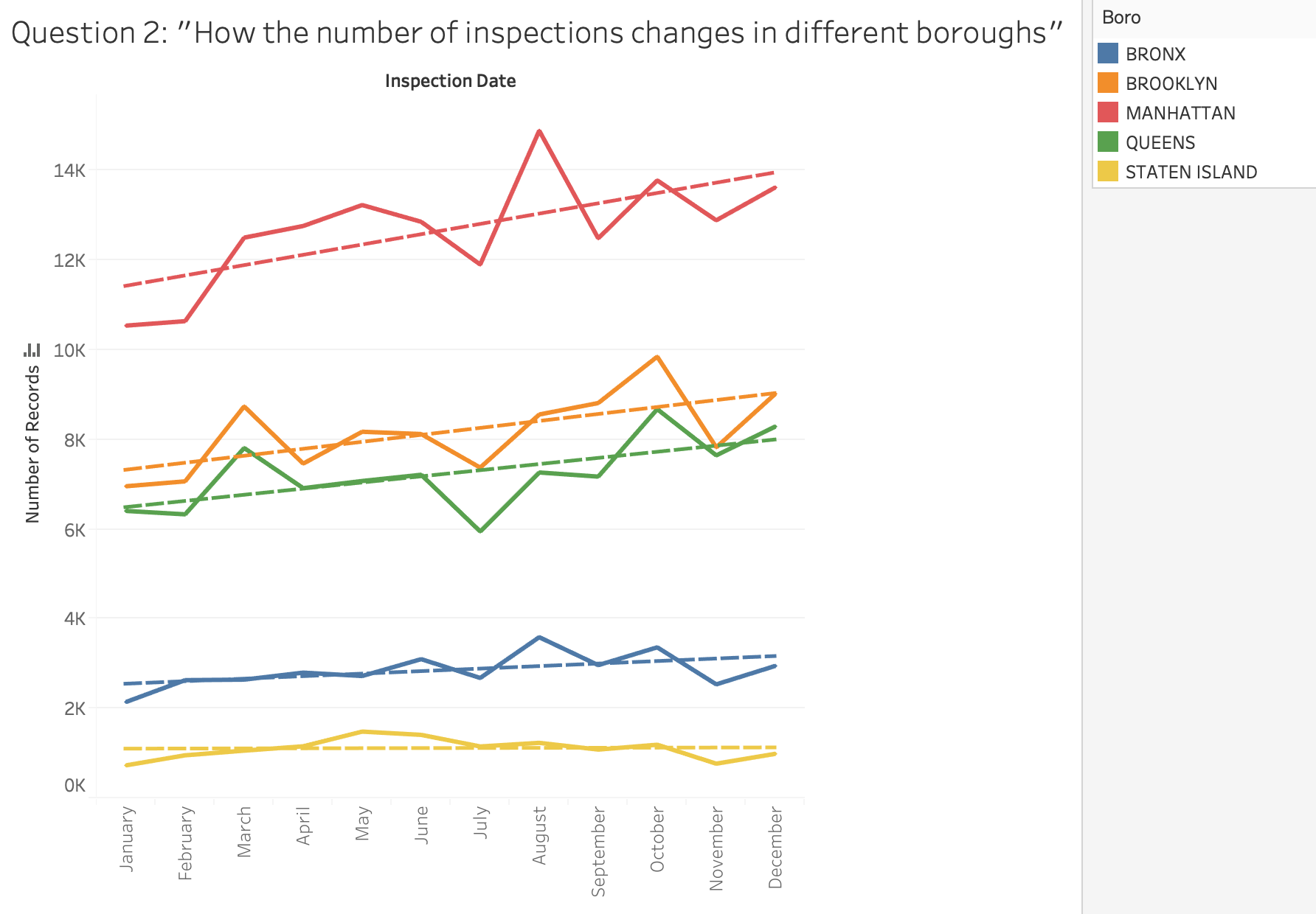

Slide 6
Answer to question 2:
The chart illustrates how the number of inspections changes throughout time for each borrow. Overall, for each borrow the figures show upward trends (I draw trend lines for each borough) except Staten Island that trend remains steadily over the time. The most frequent inspections was in Manhattan borough, where number of records exceeded more than 14k records, whereas the least visited inspections was in Staten Island, where the number of records was less than 2k records.

Slide 7
Question 3: How are cuisines types distributed across the New York area? Are there geographical areas where certain cuisines tend to concentrate (that is are there any areas where certain cuisines are more prevalent than others)? NOTE: focus only on the top 5 most frequent “Cuisine Description” categories.

Slide 8
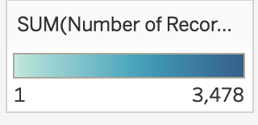



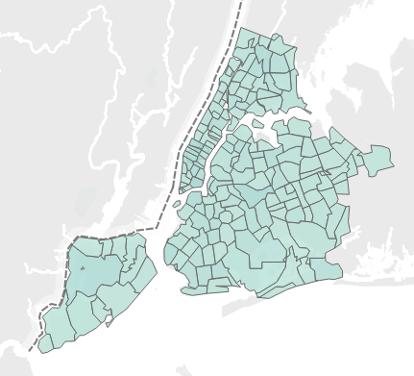

American
Latin
Chinese
Pizza
Café/Coffee/Tea

Slide 9
Answer to question 3:
The graphs illustrated above provide information how the most top 5 frequent cuisines types distributed across the New York Area. There is a additional legend that shows the number of records. I used color intensity in the map that shows where certain types of cuisines tend to concentrate. Unfortunately, I am not familiar with New York Area, and I cannot explain in the map which cuisine is more prevalent in New York Area.

Slide 10
Question 4: How does the average score compare across different cuisine types? Are there cuisines that tend to have consistently lower/higher average scores compared to the others? NOTE: focus only on the top 5 most frequent “Cuisine Description” categories.

Slide 11
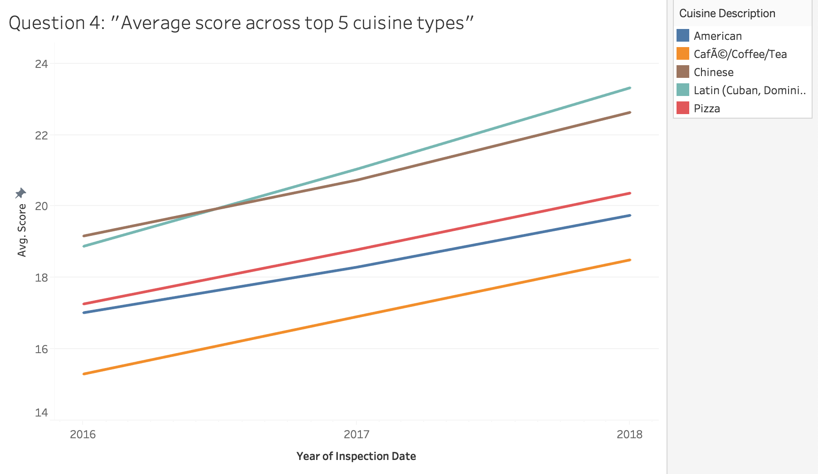

Slide 12
Answer to question 4:
The illustrated diagram shows the information how the average score for top 5 most frequent cuisine types changes over the last two years. Overall, the figures of grades for each cuisine types experience upward trends. Chinese and Latin cuisine types tend to have better score comparing with all types of cuisine over the period. Whereas, Café/Coffee/Tea type of cuisine is likely to have fewer score.

Slide 13
Question 5: Is there a relationship between cuisine type and violation? For instance, do some cuisine types tend to have more of some type of violations that other cuisine types?

Slide 14
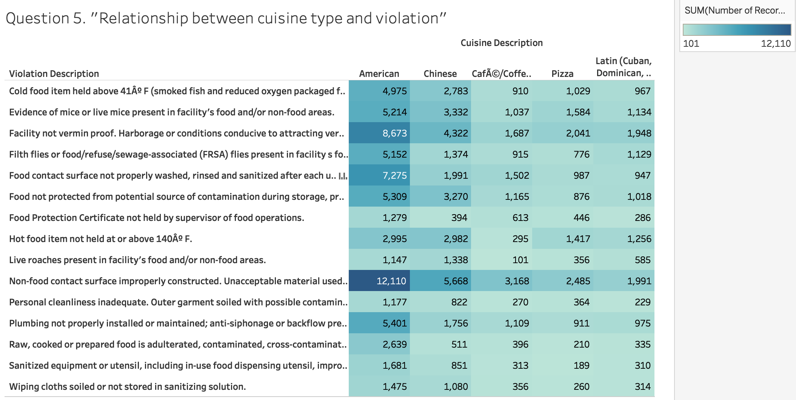

Slide 15
Answer to question 5:
As for answering for question #5, I’ve tried many graphs and I believe the matrix graph is the most suitable for this problem. In order to exclude useless information, I applied filter that shows only top 15 violation filtered by the total number of records. Additionally, I used color intensity in order to draw attention to the higher values. In the chart, we can see the most frequent types of violation for each types of cuisine:
Cuisine Description | Violation Description | Number of Records
American | Non-food contact surface improperly constructed. Unacceptable material used. Non-food contact surface or equipment improperly maintained and/or not properly sealed, raised, spaced or movable to allow accessibility for cleaning on all sides, above and underneath the unit | 12,110
Café/Coffee/ Tea | Non-food contact surface improperly constructed. Unacceptable material used. Non-food contact surface or equipment improperly maintained and/or not properly sealed, raised, spaced or movable to allow accessibility for cleaning on all sides, above and underneath the unit | 3,168
Chinese | Non-food contact surface improperly constructed. Unacceptable material used. Non-food contact surface or equipment improperly maintained and/or not properly sealed, raised, spaced or movable to allow accessibility for cleaning on all sides, above and underneath the unit | 5,668
Latin | Facility not vermin proof. Harborage or conditioning conductive to attracting vermin to the premises and/or allowing vermin to exist | 1,948
Pizza | Non-food contact surface improperly constructed. Unacceptable material used. Non-food contact surface or equipment improperly maintained and/or not properly sealed, raised, spaced or movable to allow accessibility for cleaning on all sides, above and underneath the unit | 2,485

Slide 16
Credits
Special thanks to all the people who made and released these awesome resources for free:
Presentation template by SlidesCarnival
Photographs by Unsplash & Death to the Stock Photo (license)

